Slide 1
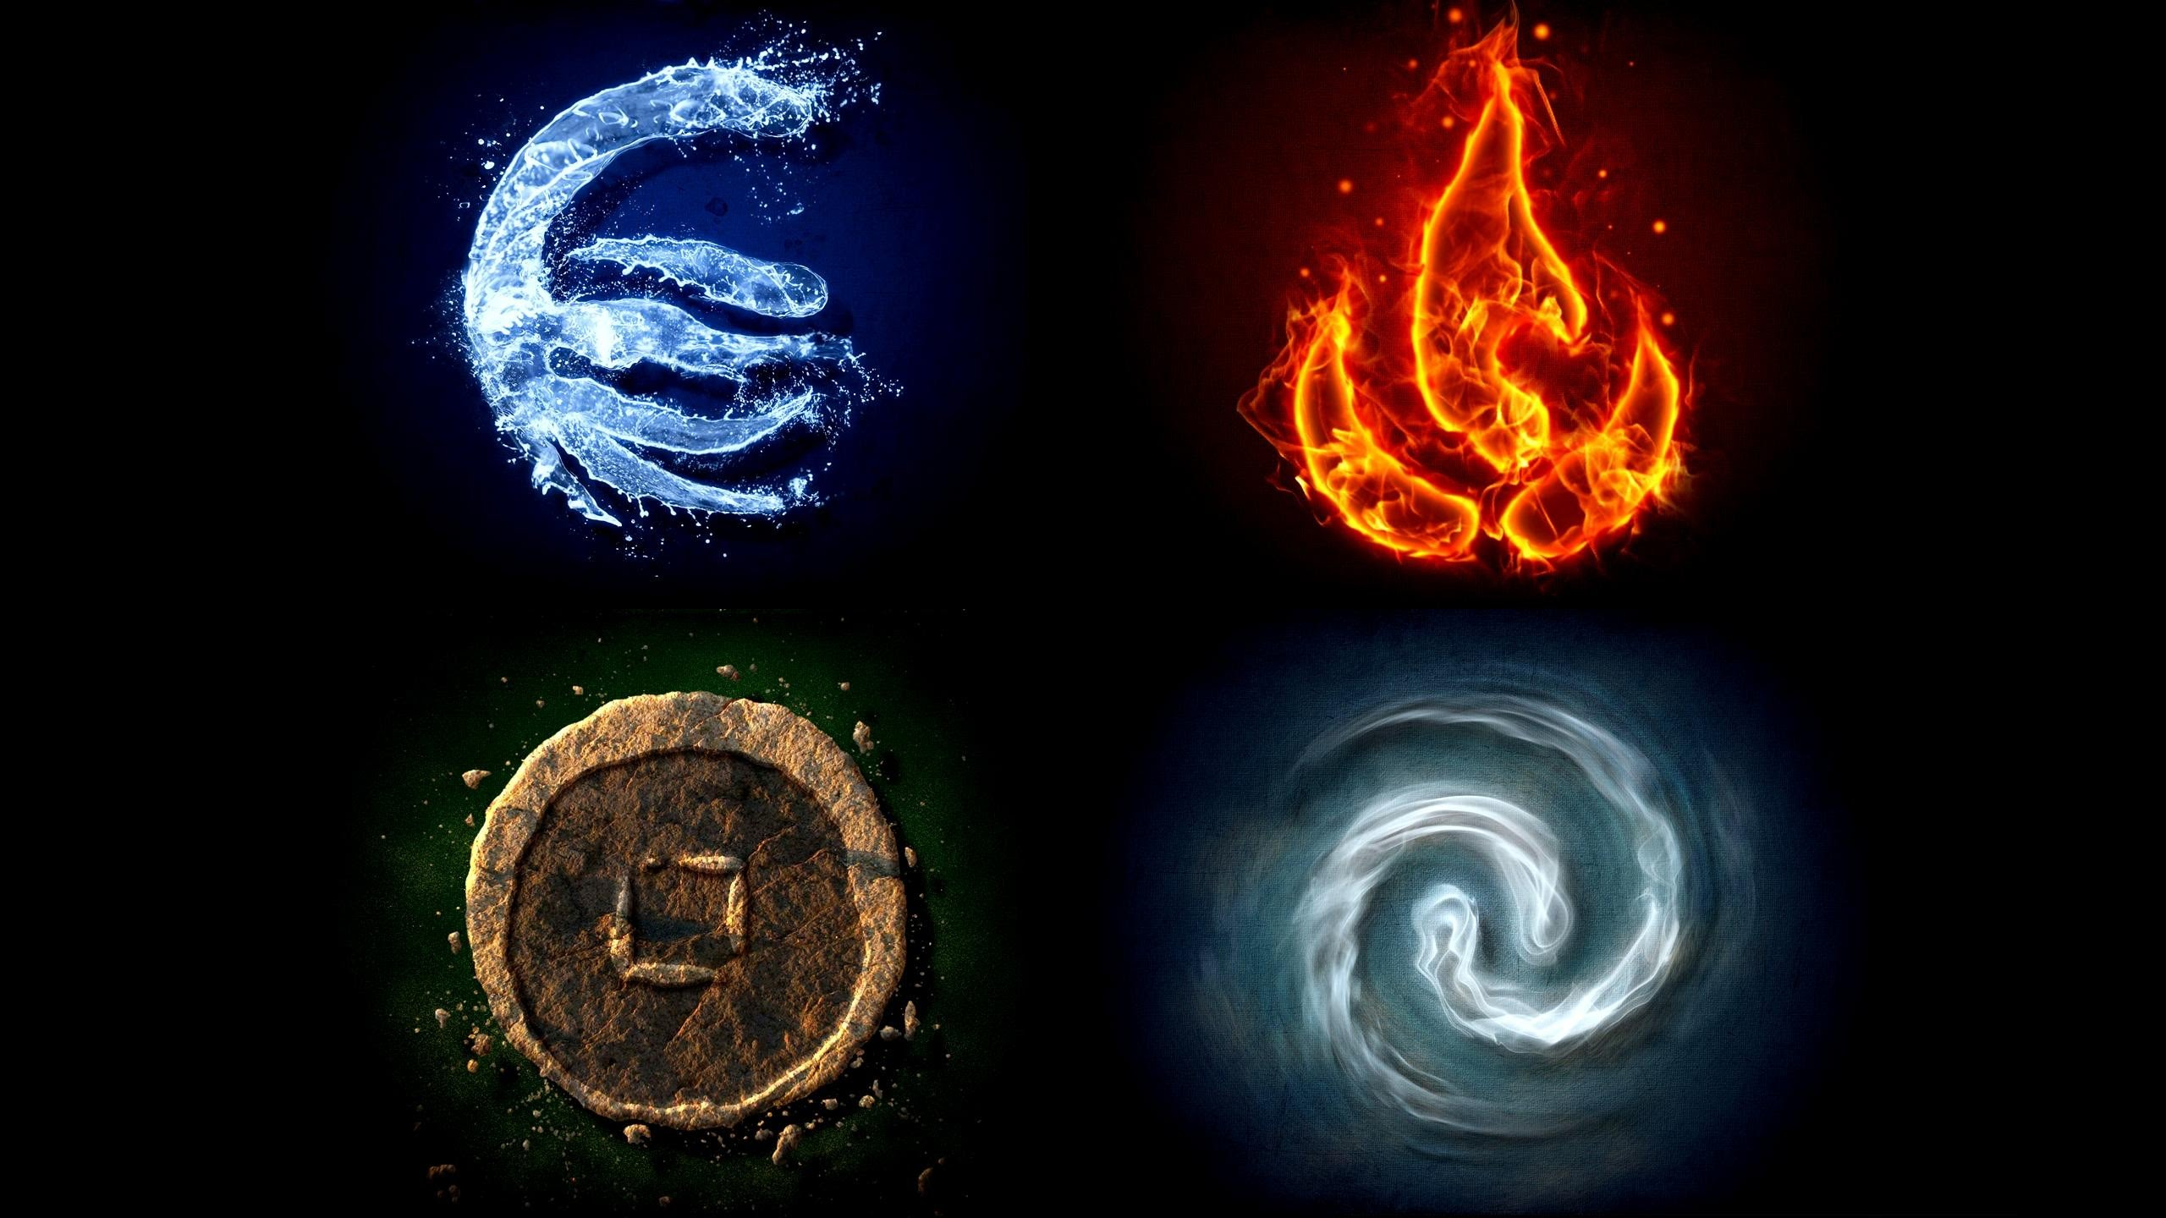
Classical Elements

Slide 2
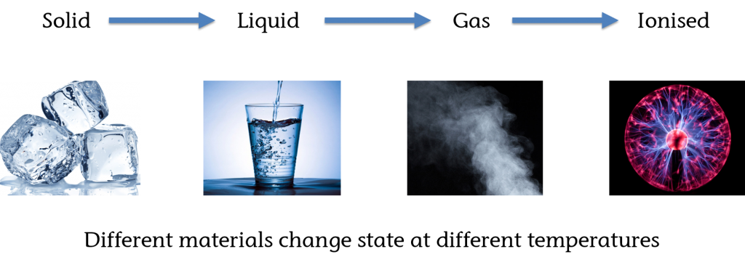

Slide 3
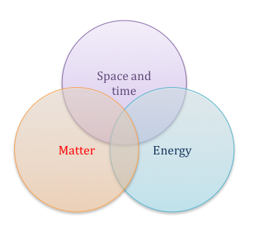

Slide 4
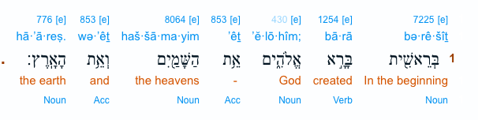
Genesis 1:1

Slide 5
John 1
1 In the beginning was the Word, and the Word was with God, and the Word was God. 2 He was with God in the beginning.

Slide 6
LOGOS
Philosophy
Rhetoric
Liguistic
Psychology
Theology

Slide 7
John 1
3 Through him all things were made;
without him nothing was made that has been made.

Slide 8


Slide 9
John 1
⁴ in him was life and that life was the light of men
Notes:
Zoe life. God’s kind of life.

Slide 10
Ephesians 5
²⁵ Husbands, love your wives, just as Christ also loved the church and gave Himself for her,
²⁸ So husbands ought to love their own wives as their own bodies; he who loves his wife loves himself.
³¹ “For this reason a man will leave his father and mother and be united to his wife, and the two will become one flesh.”^{[a]} ³² This is a profound mystery—but I am talking about Christ and the church. ³³ However, each one of you also must love his wife as he loves himself, and the wife must respect her husband.

Slide 11
You are loved with God’s standard.

Slide 12
Psalm 6
Blessed are those you choose
and bring near to live in your courts!
We are filled with the good things of your house,
of your holy temple

Slide 13
John 1
¹¹ He came to that which was his own, but his own did not receive him. ¹² Yet to all who did receive him, to those who believed in his name, he gave the right to become children of God

Slide 14
3 Hard Questions
God’s will ?
God’s work ?
God’s commandment ?

Slide 15
John 6
³⁸ For I have come down from heaven not to do my will but to do the will of him who sent me.
³⁹ And this is the will of him who sent me, that I shall lose none of all those he has given me, but raise them up at the last day.
⁴⁰ For my Father’s will is that everyone who looks to the Son and believes in him shall have eternal life, and I will raise them up at the last day.”

Slide 16
John 6:29
²⁹ Jesus answered, “The work of God is this: to believe in the one he has sent.”

Slide 17
God’s commandment
John 13:34
2 John 1:5
John 15:12
John 15:7

Slide 18
Knowing God
God Father – John 6:45
Son -- 1 John 2:27
Holy Spirit – John 14:26

Slide 19
John 1
¹² Yet to all who did receive him, to those who believed in his name, he gave the right to become children of God— ¹³ children born not of natural descent, nor of human decision or a husband’s will, but born of God.

Slide 20
John 1
¹⁴ The Word became flesh and made his dwelling among us. We have seen his glory, the glory of the one and only Son, who came from the Father, full of grace and truth.

Slide 21
John 1
18 No one has ever seen God, but the one and only Son, who is himself God and is in closest relationship with the Father, has made him known.

